Slide 1

Meeting 4
Vinzenz Tütsch
11.01.2024

Slide 2
Topics
Code & Simulation
Paper

Slide 3
Code & Simulation
Changed implementation (slower parallel implementation)
Completed setup in euler (issues with ray)
Simulation (penalty 1: 324 combinations, penalty 2: 12 combinations)
Find large network
Fixed Time Controller

Slide 4
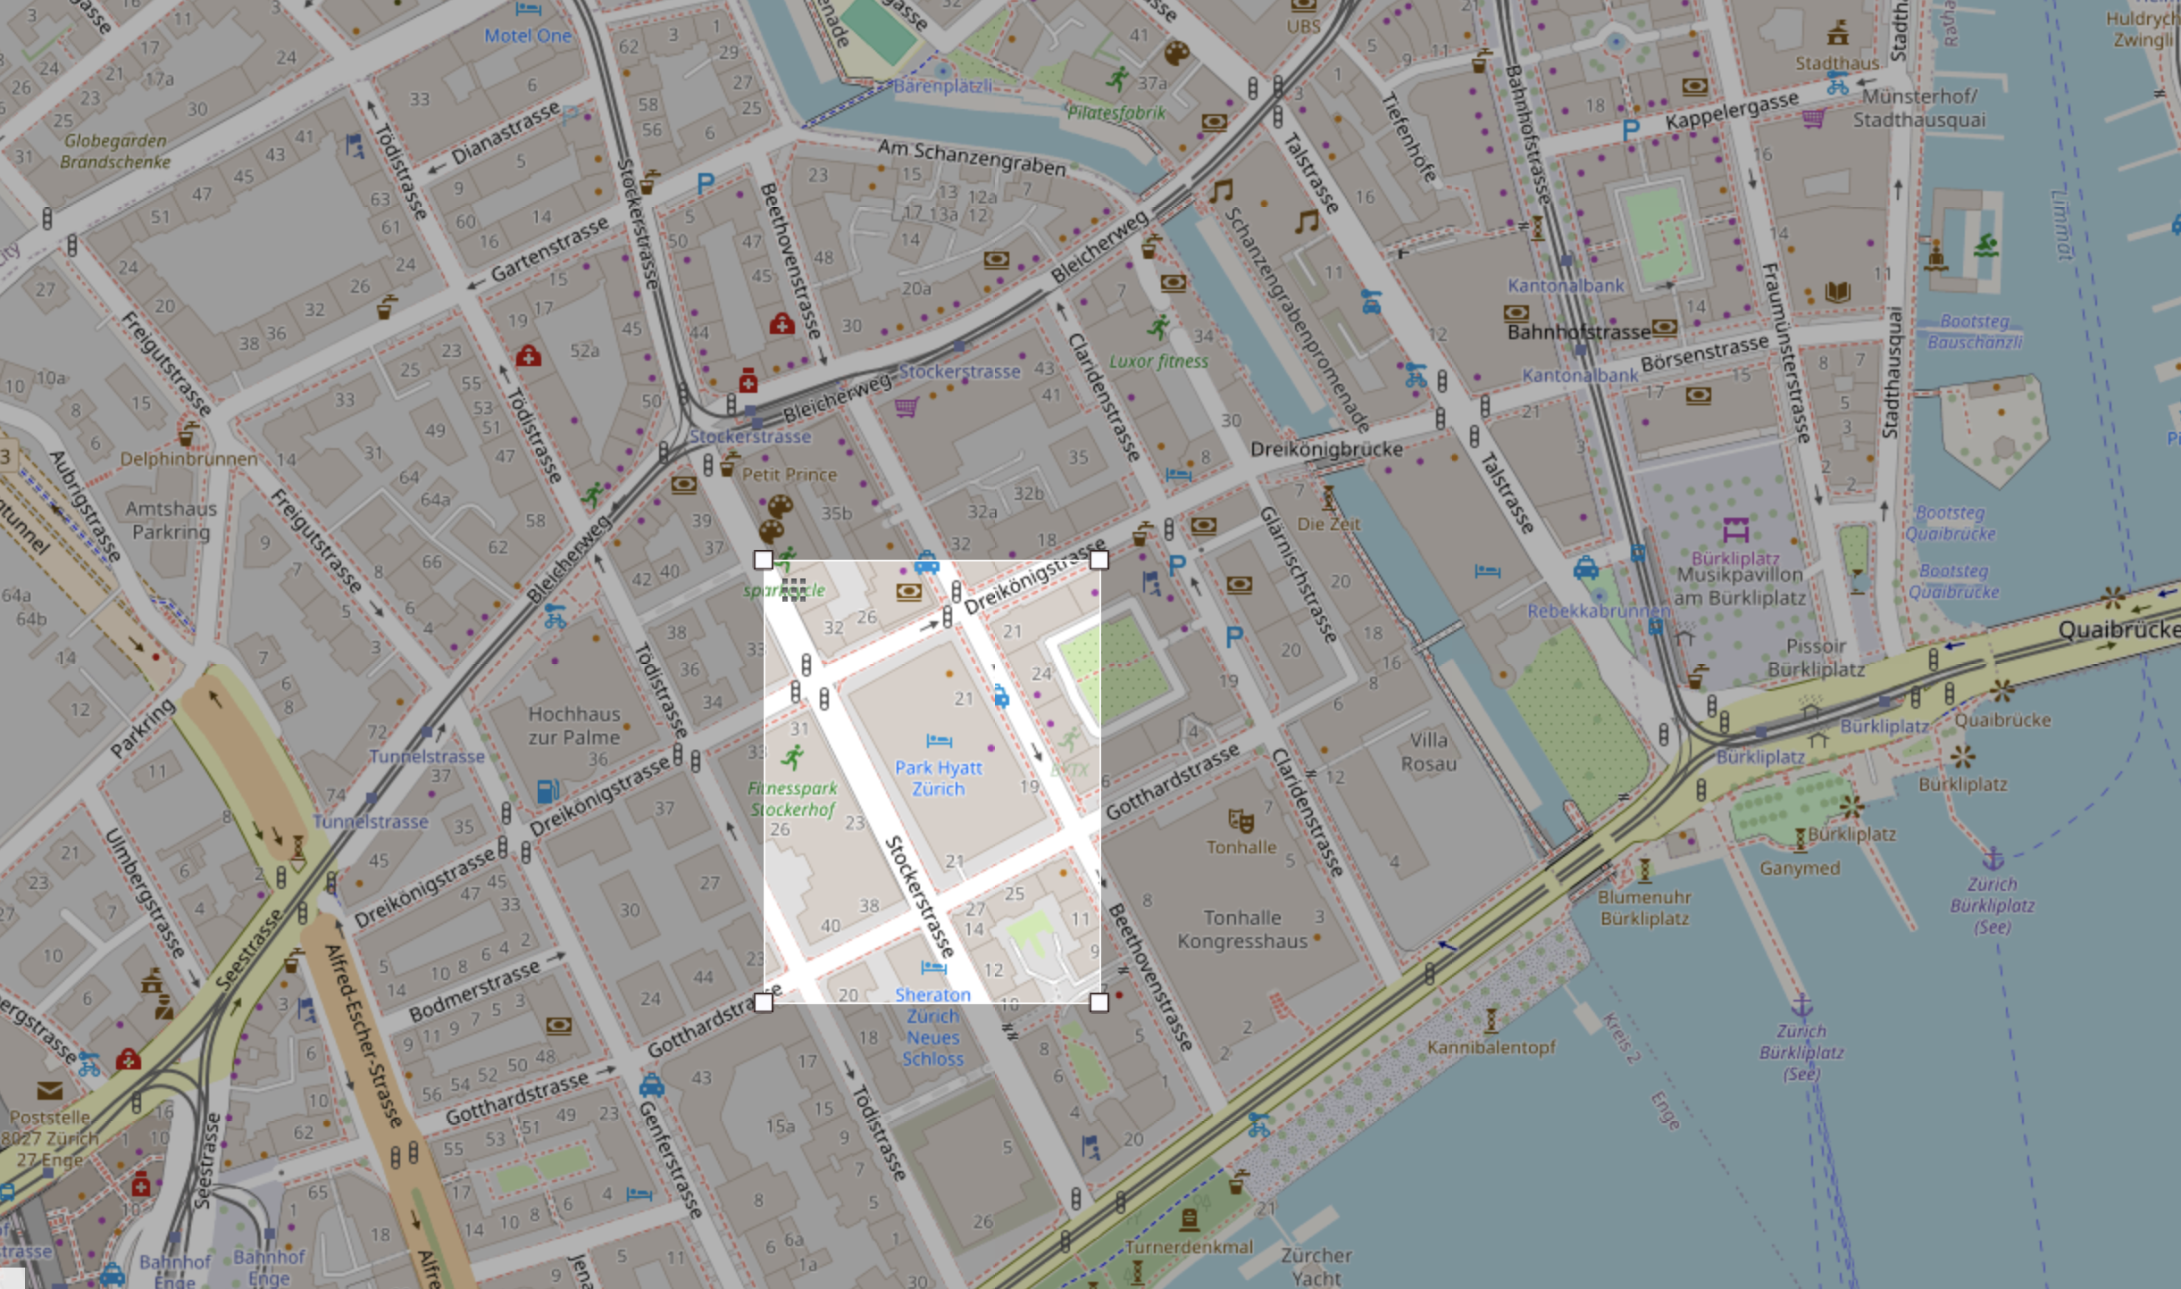
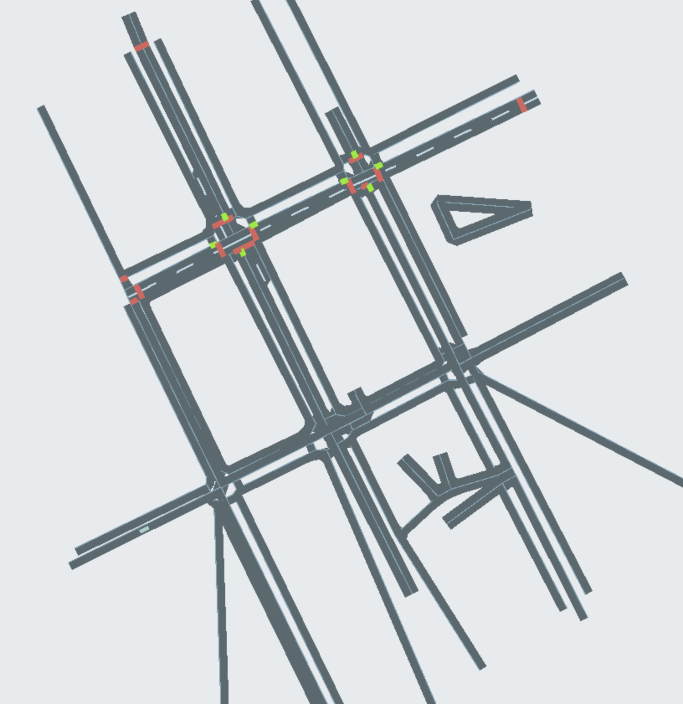
Large Network
No traffic light
Additional lanes
Download SUMO?

Slide 5
Paper
Structure of paper so far
Introduction: Literature Review, Contributions and Organization
Literature Review: Theoretically proven algorithm for discrete objective function with binary variables?
Problem Formulation and Preliminaries: Queuing network topology, Max Pressure, Centralized
Lyapunov Drift Plus Penalty: Lyapunov Drift Optimization, Lyapunov Drift Plus Penalty, Stability and Performance Anaylsis
Consensus: ADMM, Greedy
Conclusion and Future

Slide 6
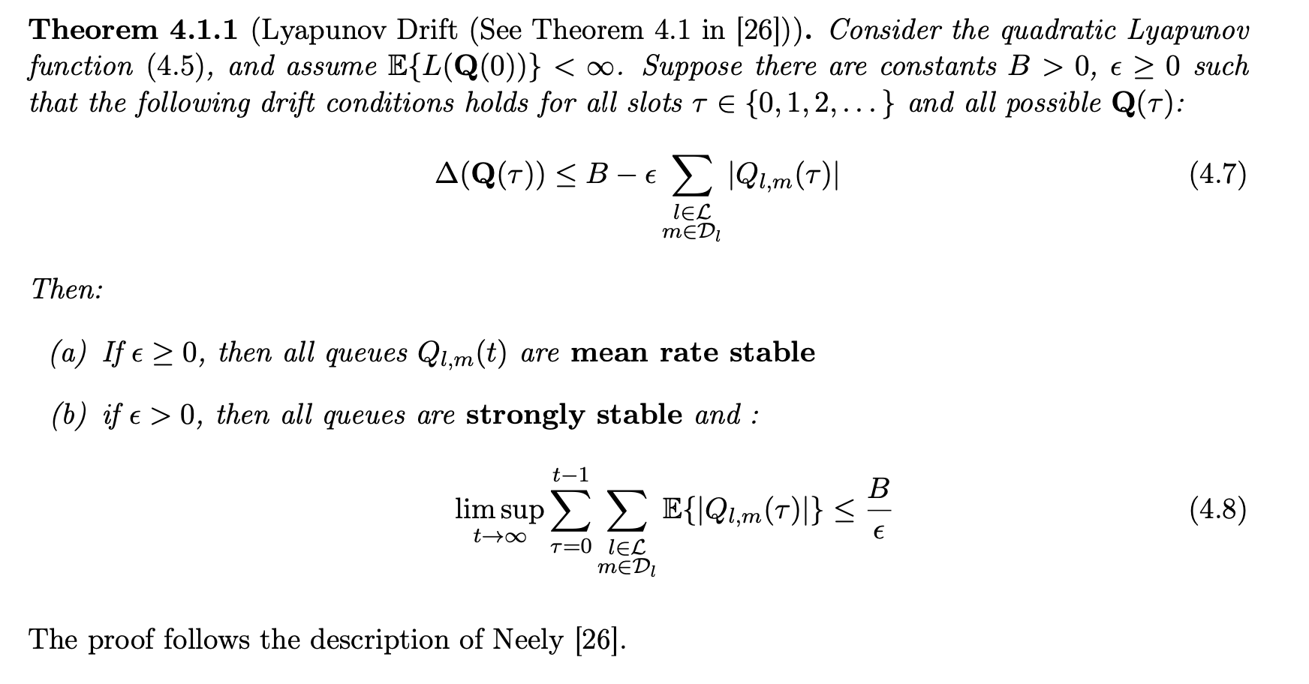
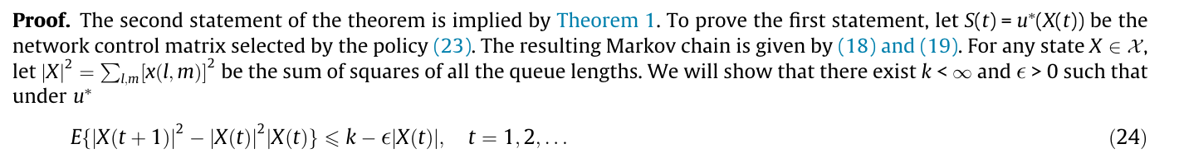
Paper
Stability: Only consider strongly stable?

Slide 7
Paper
Using theory with omega-only policy or just refer to Neely? (not just a copy of Neely)

